Slide 1
Magic bubble tea vending machine
Ls L
Hh C
Yh P
Cd S

Slide 2
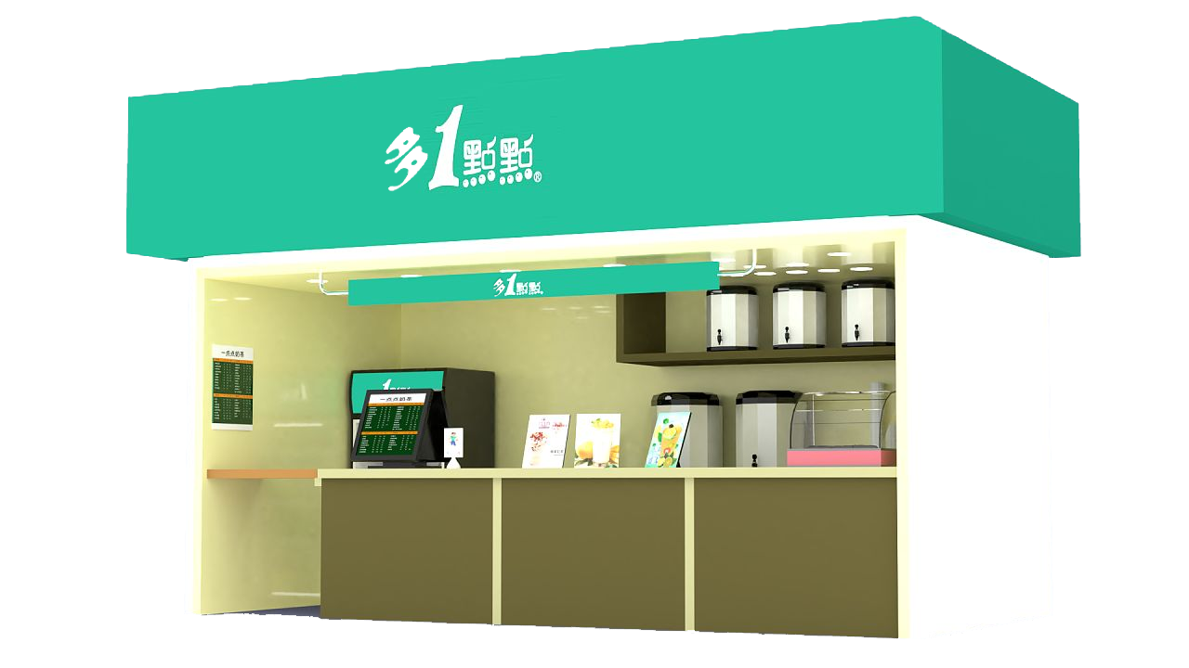
Theme: Make them happy
Let customers enjoy
the process of
waiting bubble tea

Slide 3






HCD(Process) IS0 9241-210
Understand and Specify the Context of Use
Plan the Human-Centered
Design Process
Specify the User Requirements
Iterate Where
Appropriate
Evaluate the Design Against Requirements
Designed Solutions Meet User Requirements
Produce Design Solutions to Meet User Requirements

Slide 4
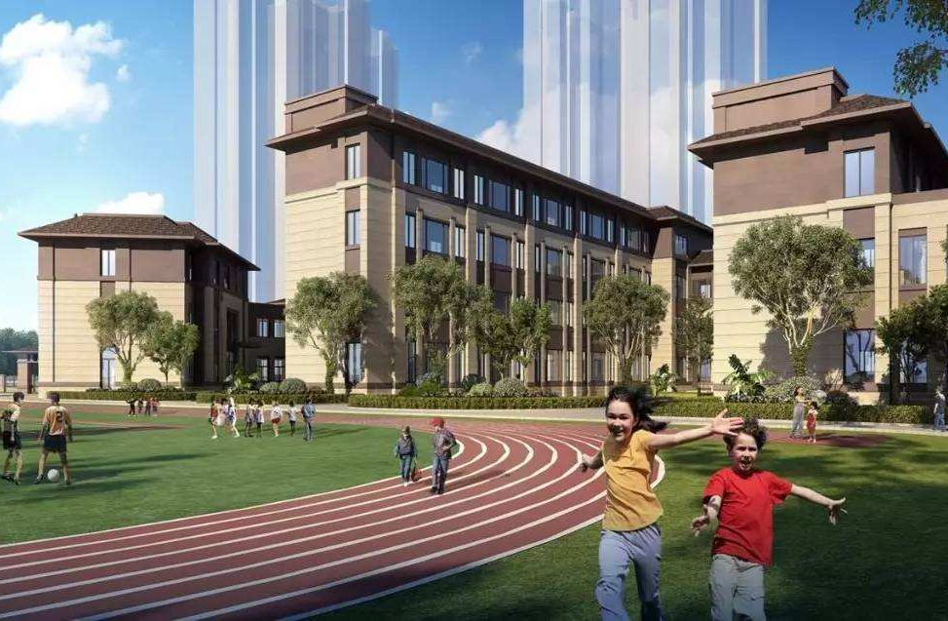
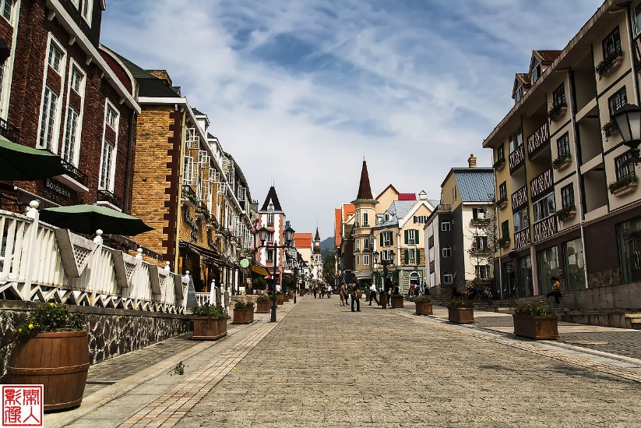
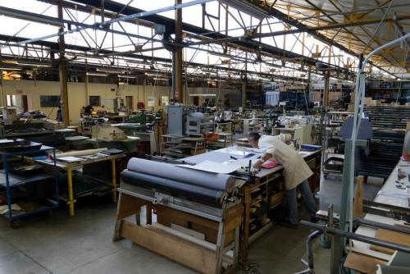
Touch points
campus
road
factory

Slide 5
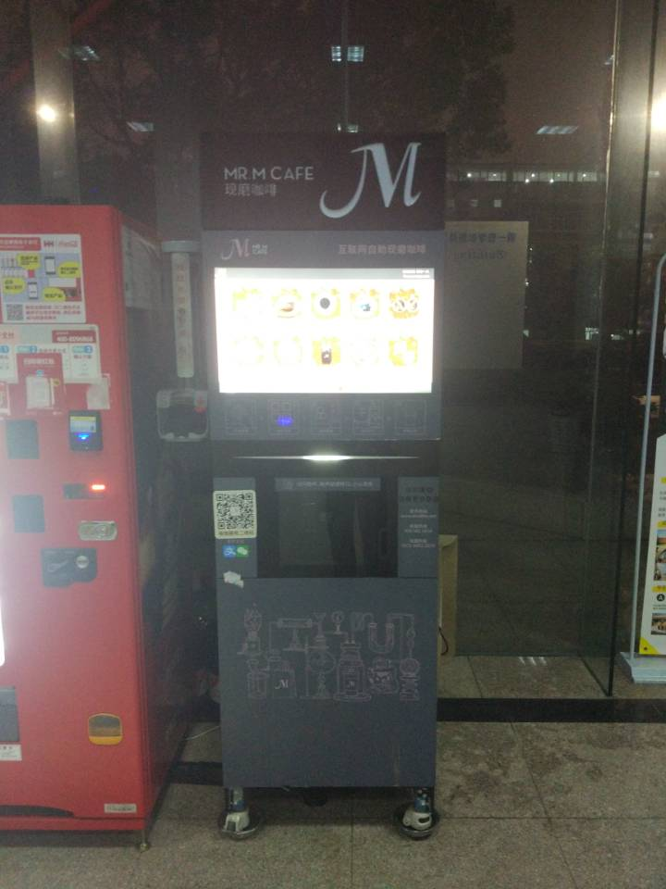
This is our automatic bubble tea vending machine！

Slide 6
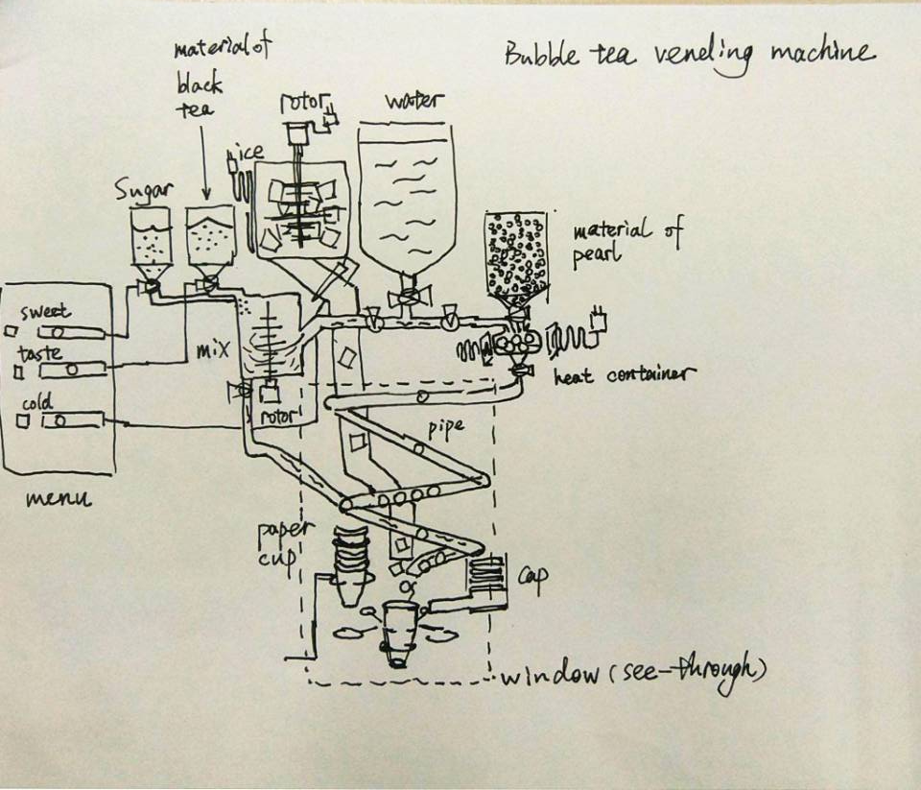
MaMi
MaMi
Hong!!!

Slide 7
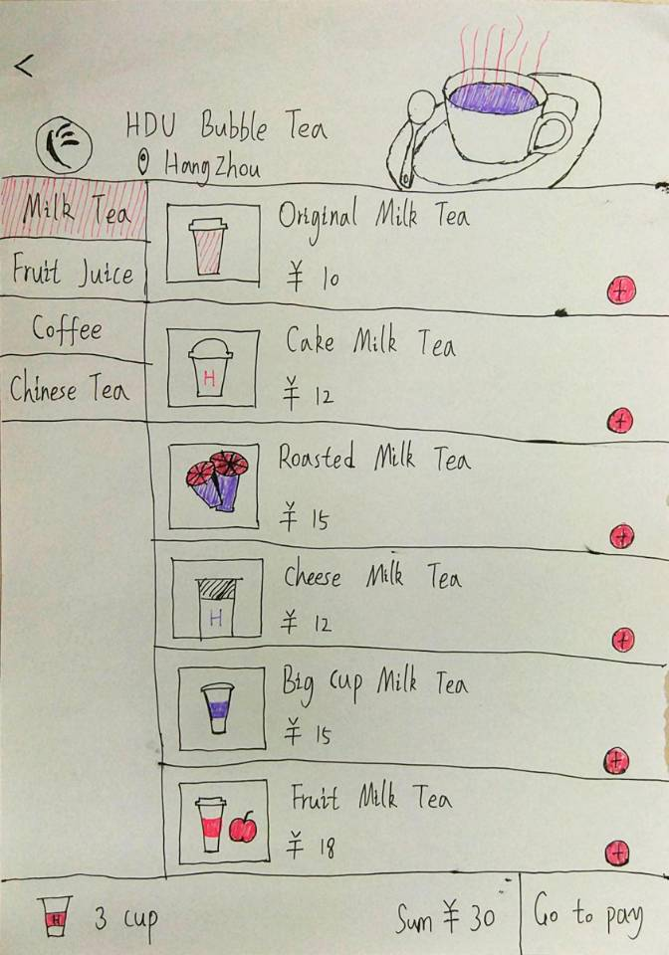
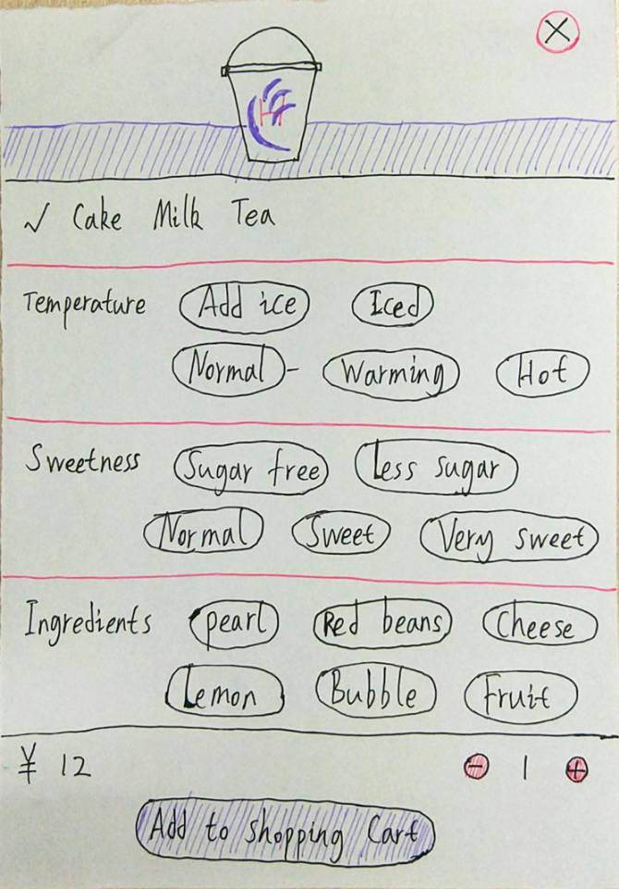
This is our menu, you can make bubble tea that belongs to your taste！

Slide 8
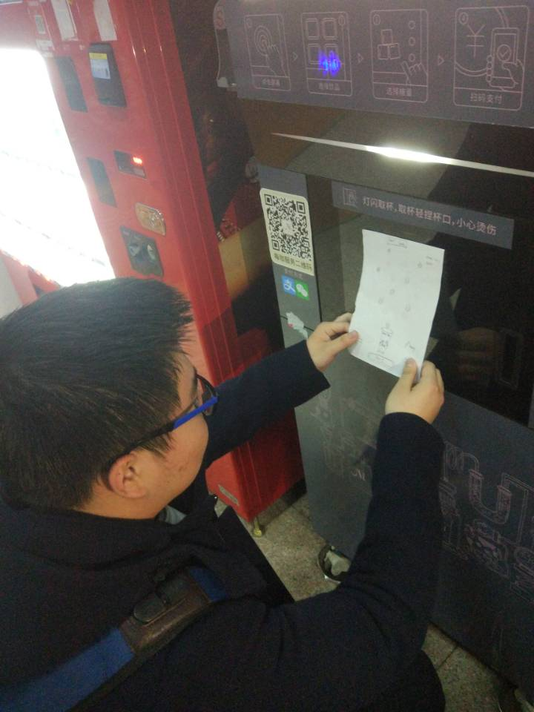
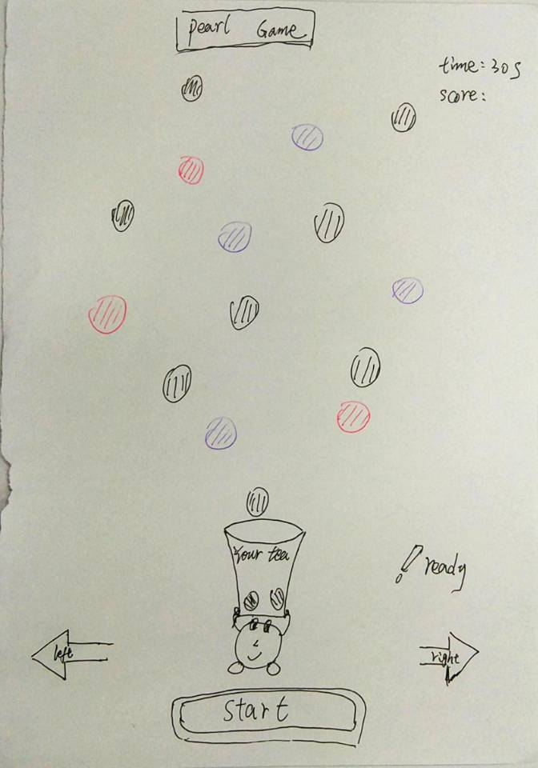
Wow！
what is this little fat doing ?

Slide 9
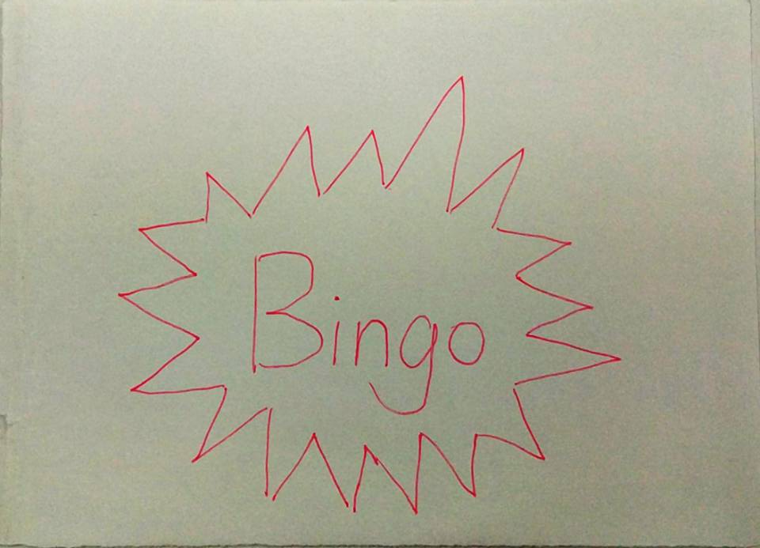
This is a
magical game! Bubbles,
red beans, chocolate, come quickly into the bowl!
Bingo!

Slide 10
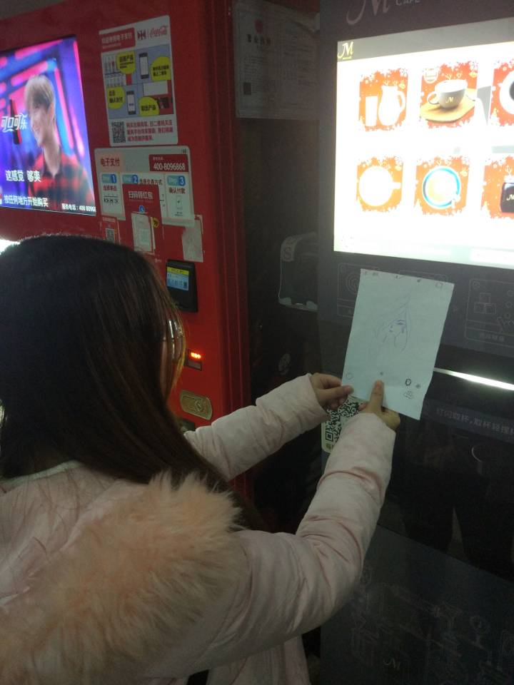
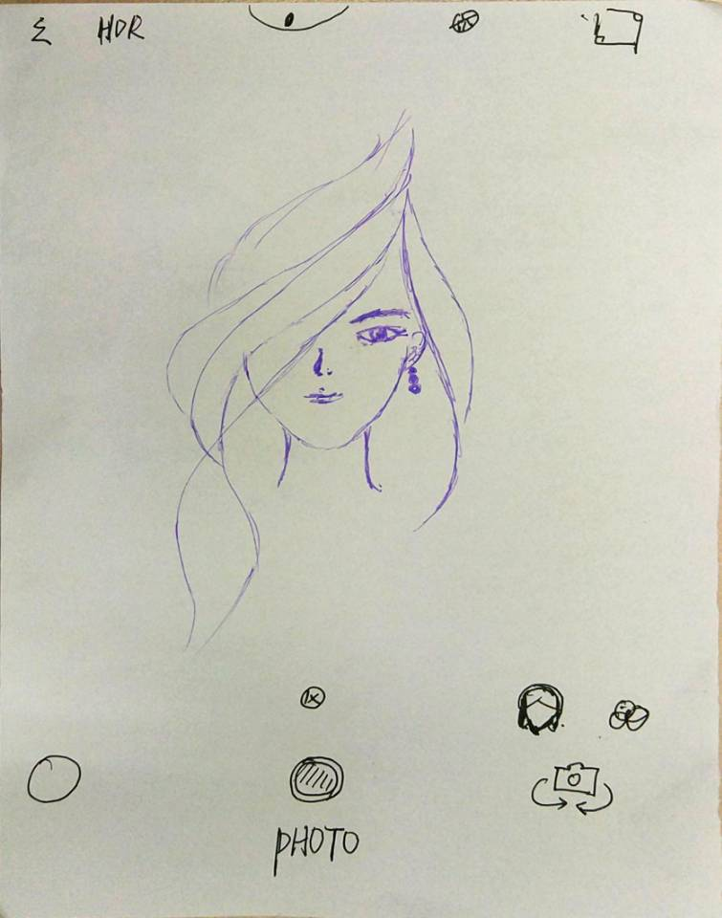
Look！
what is this beauty doing?

Slide 11
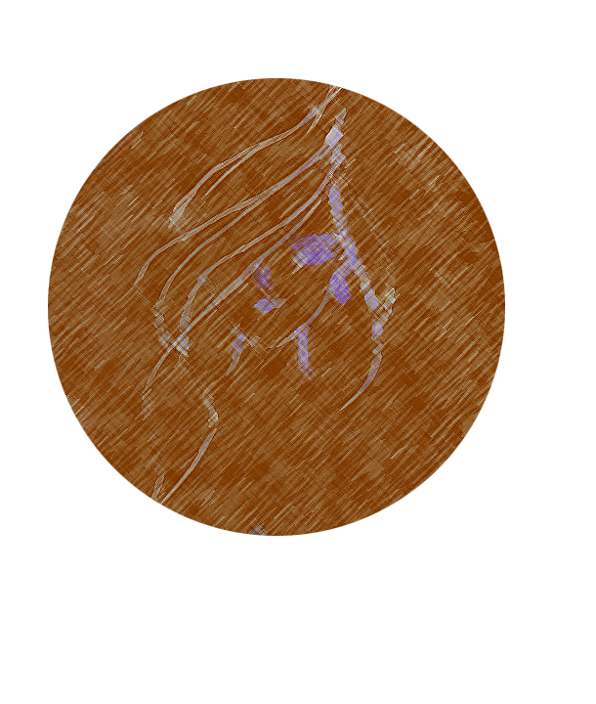
Her face will be made on bubble tea.

Slide 12
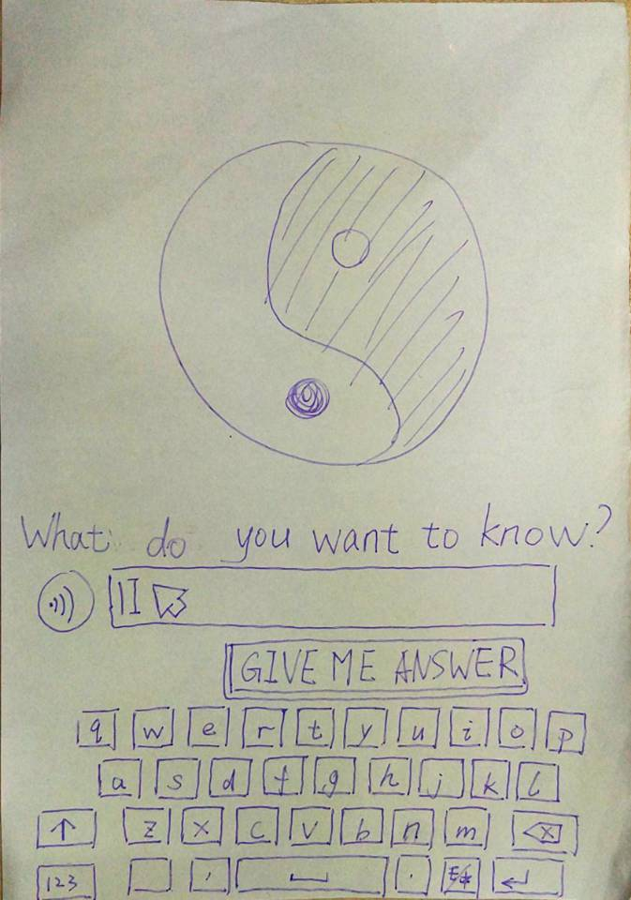
Not only that, but
this machine can also get feedback : ）

Slide 13


